Slide 1

Fabrice LEROY

Slide 2
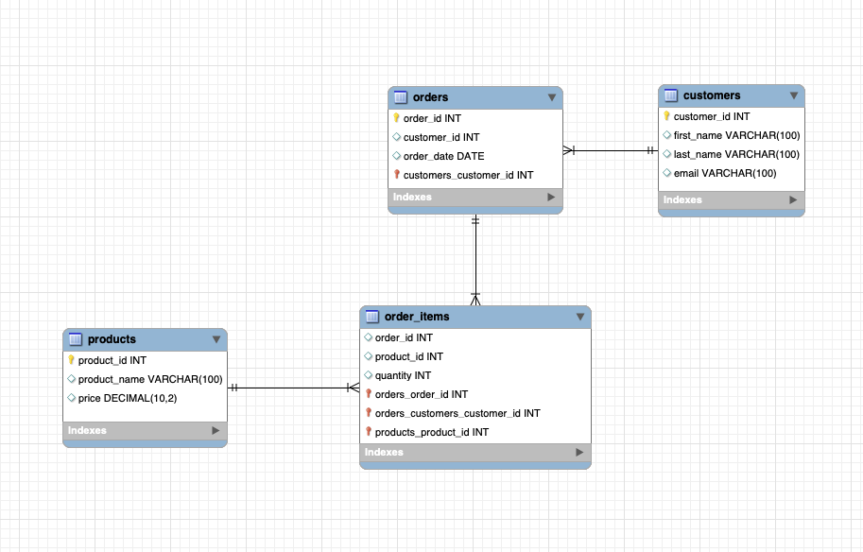
The Database Model

Slide 3

1) Which product has the highest price? Only return a single row.
SELECT product_id, product_name, price
FROM products
ORDER BY price DESC
LIMIT 1;
Fabrice LEROY

Slide 4

2) Which customer has made the most orders?
SELECT customers.customer_id, customers.first_name, customers.last_name, COUNT(orders.order_id) AS total_orders
FROM customers
JOIN orders ON customers.customer_id = orders.customer_id
GROUP BY customers.customer_id, customers.first_name, customers.last_name
ORDER BY total_orders DESC
LIMIT 1;
Fabrice LEROY

Slide 5
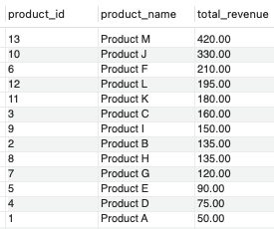
3) What’s the total revenue per product?
SELECT
products.product_id,
products.product_name,
SUM(order_items.quantity * products.price) AS total_revenue
FROM products
JOIN order_items ON products.product_id = order_items.product_id
GROUP BY products.product_id, products.product_name
ORDER BY total_revenue DESC;
Fabrice LEROY

Slide 6

4) Find the day with the highest revenue.
SELECT
DATE_FORMAT(orders.order_date, '%m/%d/%Y') AS order_date,
SUM(order_items.quantity * products.price) AS total_revenue
FROM orders
JOIN order_items ON orders.order_id = order_items.order_id
JOIN products ON order_items.product_id = products.product_id
GROUP BY order_date
ORDER BY total_revenue DESC
LIMIT 1;
Fabrice LEROY

Slide 7
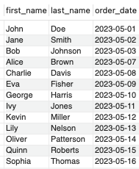
5) Find the first order (by date) for each customer
SELECT
customers.first_name,
customers.last_name,
orders.order_date
FROM
customers
JOIN
(SELECT
customer_id,
MIN(order_date) as min_order_date
FROM
orders
GROUP BY
customer_id) as first_orders
ON
customers.customer_id = first_orders.customer_id
JOIN
orders
ON
customers.customer_id = orders.customer_id
AND orders.order_date = first_orders.min_order_date;
Fabrice LEROY

Slide 8

6) Find the top 3 customers who have ordered the most distinct products
SELECT
customers.first_name,
customers.last_name,
COUNT(DISTINCT order_items.product_id) as distinct_product_count
FROM
customers
JOIN
orders ON customers.customer_id = orders.customer_id
JOIN
order_items ON orders.order_id = order_items.order_id
GROUP BY
customers.customer_id
ORDER BY
distinct_product_count DESC
LIMIT 3;
Fabrice LEROY

Slide 9

7) Which product has been bought the least in terms of quantity?
SELECT
products.product_name,
SUM(order_items.quantity) as total_quantity
FROM
products
JOIN
order_items ON products.product_id = order_items.product_id
GROUP BY
products.product_id
ORDER BY
total_quantity ASC
LIMIT 1;
Fabrice LEROY

Slide 10

8) What is the median order total ?
SELECT AVG(order_total) AS median_order_total
FROM (
SELECT order_total, @rownum := @rownum + 1 AS rn, @total_rows AS total_rows
FROM (
SELECT SUM(order_items.quantity * products.price) AS order_total
FROM orders
JOIN order_items ON orders.order_id = order_items.order_id
JOIN products ON order_items.product_id = products.product_id
GROUP BY orders.order_id
ORDER BY order_total
) AS ranked_order_totals
CROSS JOIN (SELECT @rownum := 0, @total_rows := COUNT(*) FROM (SELECT SUM(order_items.quantity * products.price) AS order_total FROM orders JOIN order_items ON orders.order_id = order_items.order_id JOIN products ON order_items.product_id = products.product_id GROUP BY orders.order_id) AS t) AS vars
) AS medians
WHERE rn IN (FLOOR((total_rows + 1) / 2), CEIL((total_rows + 1) / 2));
Fabrice LEROY

Slide 11
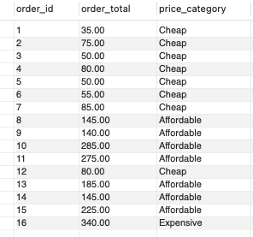
9) For each order, determine if it was ‘Expensive’ (total over 300),
‘Affordable’ (total over 100), or ‘Cheap’.
SELECT
orders.order_id,
SUM(order_items.quantity * products.price) as order_total,
CASE
WHEN SUM(order_items.quantity * products.price) > 300 THEN 'Expensive'
WHEN SUM(order_items.quantity * products.price) > 100 THEN 'Affordable'
ELSE 'Cheap'
END as price_category
FROM
orders
JOIN
order_items ON orders.order_id = order_items.order_id
JOIN
products ON order_items.product_id = products.product_id
GROUP BY
orders.order_id;
Fabrice LEROY

Slide 12

10) Find customers who have ordered the product with the highest price.
SELECT DISTINCT c.first_name, c.last_name, p.product_name, p.price
FROM customers c
JOIN orders o ON c.customer_id = o.customer_id
JOIN order_items oi ON o.order_id = oi.order_id
JOIN products p ON oi.product_id = p.product_id
WHERE p.product_id IN (
SELECT product_id
FROM products
WHERE price = (SELECT MAX(price) FROM products)
);
Fabrice LEROY

